Slide 1
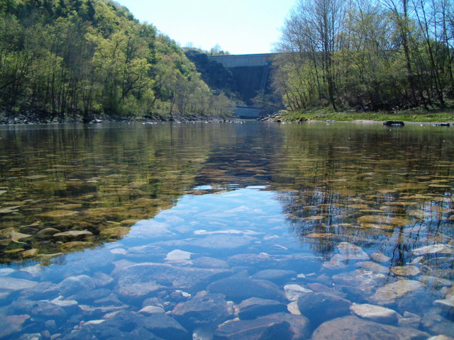
Ozarks Water Watch
Protecting and Preserving our Ozarks Heritage
Notes:
Title Page

Slide 2
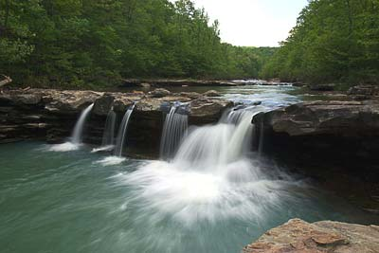
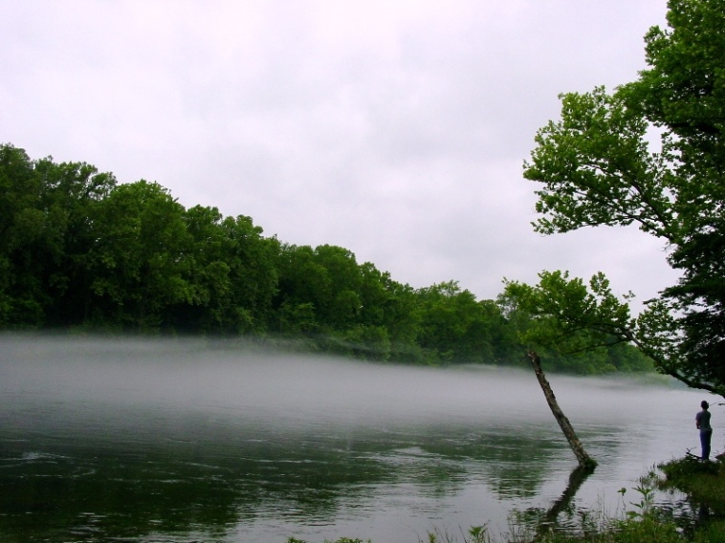
Our Mission
To promote water quality in the upper White River watershed through collaboration on research, education, public policy and action projects basin-wide in both Arkansas and Missouri.
Notes:
The UWRB Mission

Slide 3
Board of Trustees
Peter Herschend—Chairman
Herschend Family Entertainment
Branson, Missouri
Alan Fortenberry-Vice-Chairman
Beaver Water District
Lowell, Arkansas
Martin MacDonald—Secretary
Bass Pro Shops
Springfield, Missouri
Todd Parnell—Treasurer
Drury University
Springfield, Missouri
Charles Zimmerman, Walmart
Bentonville, Arkansas
Leon Combs, Beaver Creek Publishing
Bradleyville, Missouri
Jack Herschend, Herschend Family Entertainment
Branson, Missouri
Andy Southerly, Cargill Meat Solutions
Springdale, Arkansas
John Morris, Bass Pro Shops
Springfield, Missouri
John Moore, Retired
Springfield, Missouri
Archie Schaffer, Tyson Foods, Inc.
Springdale, Arkansas
Joe White, Kanakuk Kamps
Branson, Missouri
Notes:
Board of Trustees

Slide 4
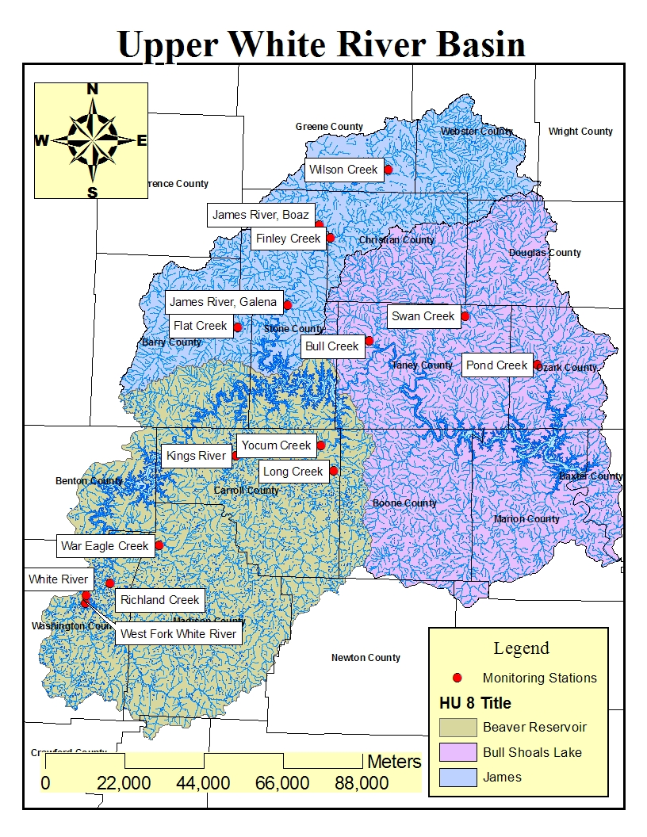
THE UPPER WHITE RIVER BASIN REGION:
Covers 19 counties across Missouri and Arkansas
Encompasses 14,000 square miles of land
Includes four lakes—Beaver, Bull Shoals, Taneycomo and Table Rock
Is home to over 1 million people
Notes:
Upper White River watershed region with Roads/Political boundaries map and statistical data of region.

Slide 5
Program Priorities
Monitor and report on water quality in the basin.
Provide advocacy on public policy issues which affect water quality and watersheds.
Emphasize public information, education, promotion and communication about water quality issues.
Support and encourage allied watershed groups working for common purpose.
Seek long-term sustainable funding support for water quality work in the Ozarks.
Notes:
Program Priorities

Slide 6
LID: Low Impact Development
Notes:
Priority Project to Monitor, Measure and Report on Water Quality in the Basin.

Slide 7
LID: Low Impact Development a design manual for urban areas
Fay Jones School of Architecture
University of Arkansas
A Collaboration
Fayetteville 2010
http://uacdc.uark.edu
Over 225 pages
$30 a copy

Slide 8
Real Life Examples
Beaver Water District, Lowell, AR
Green Circle Shopping Center, Springfield, MO

Slide 10
SLOW SPREAD SOAK

Slide 11
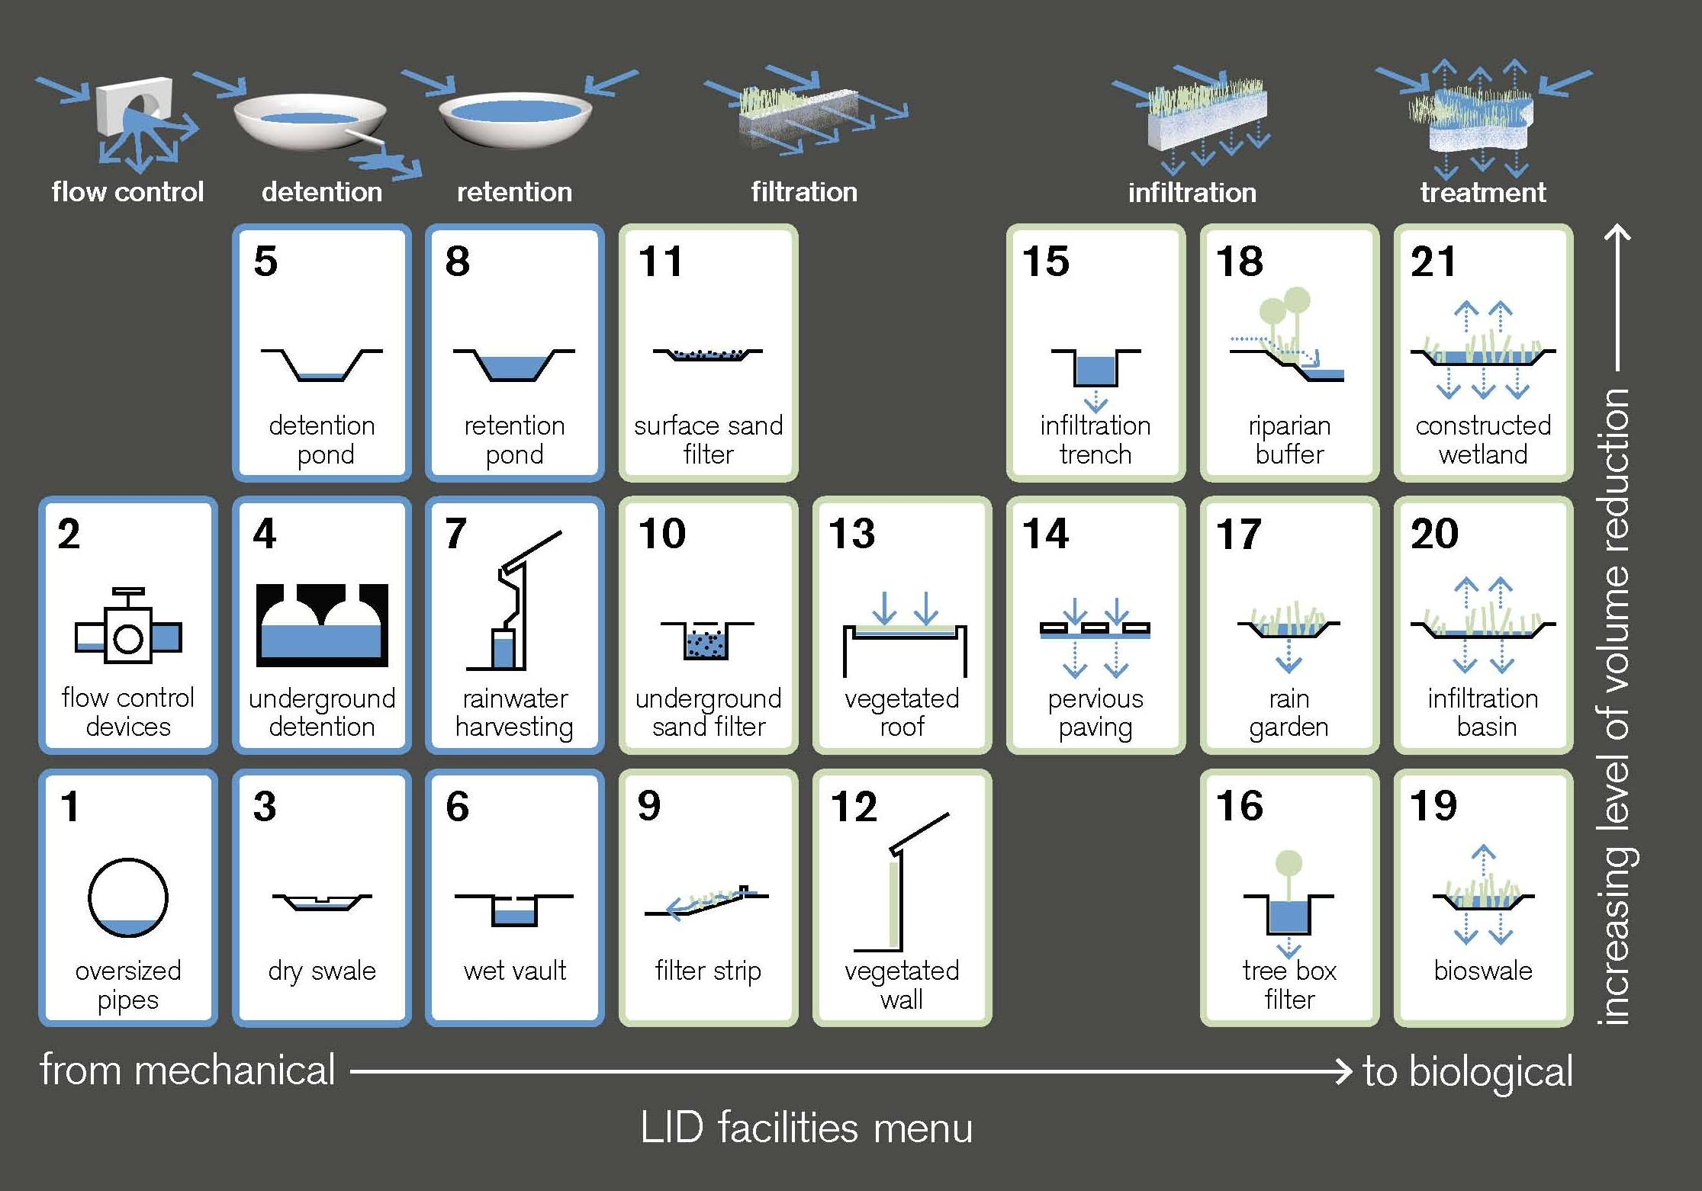
LID Facilities

Slide 13
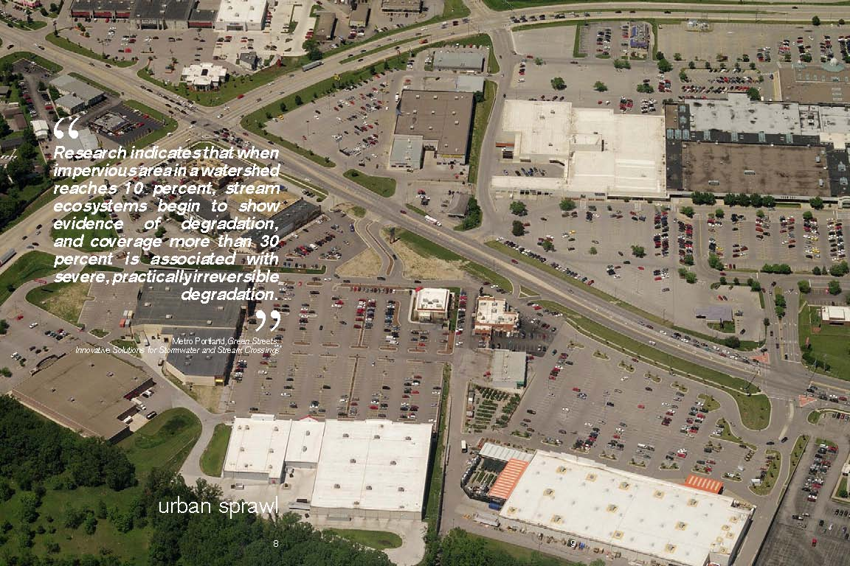

Slide 15
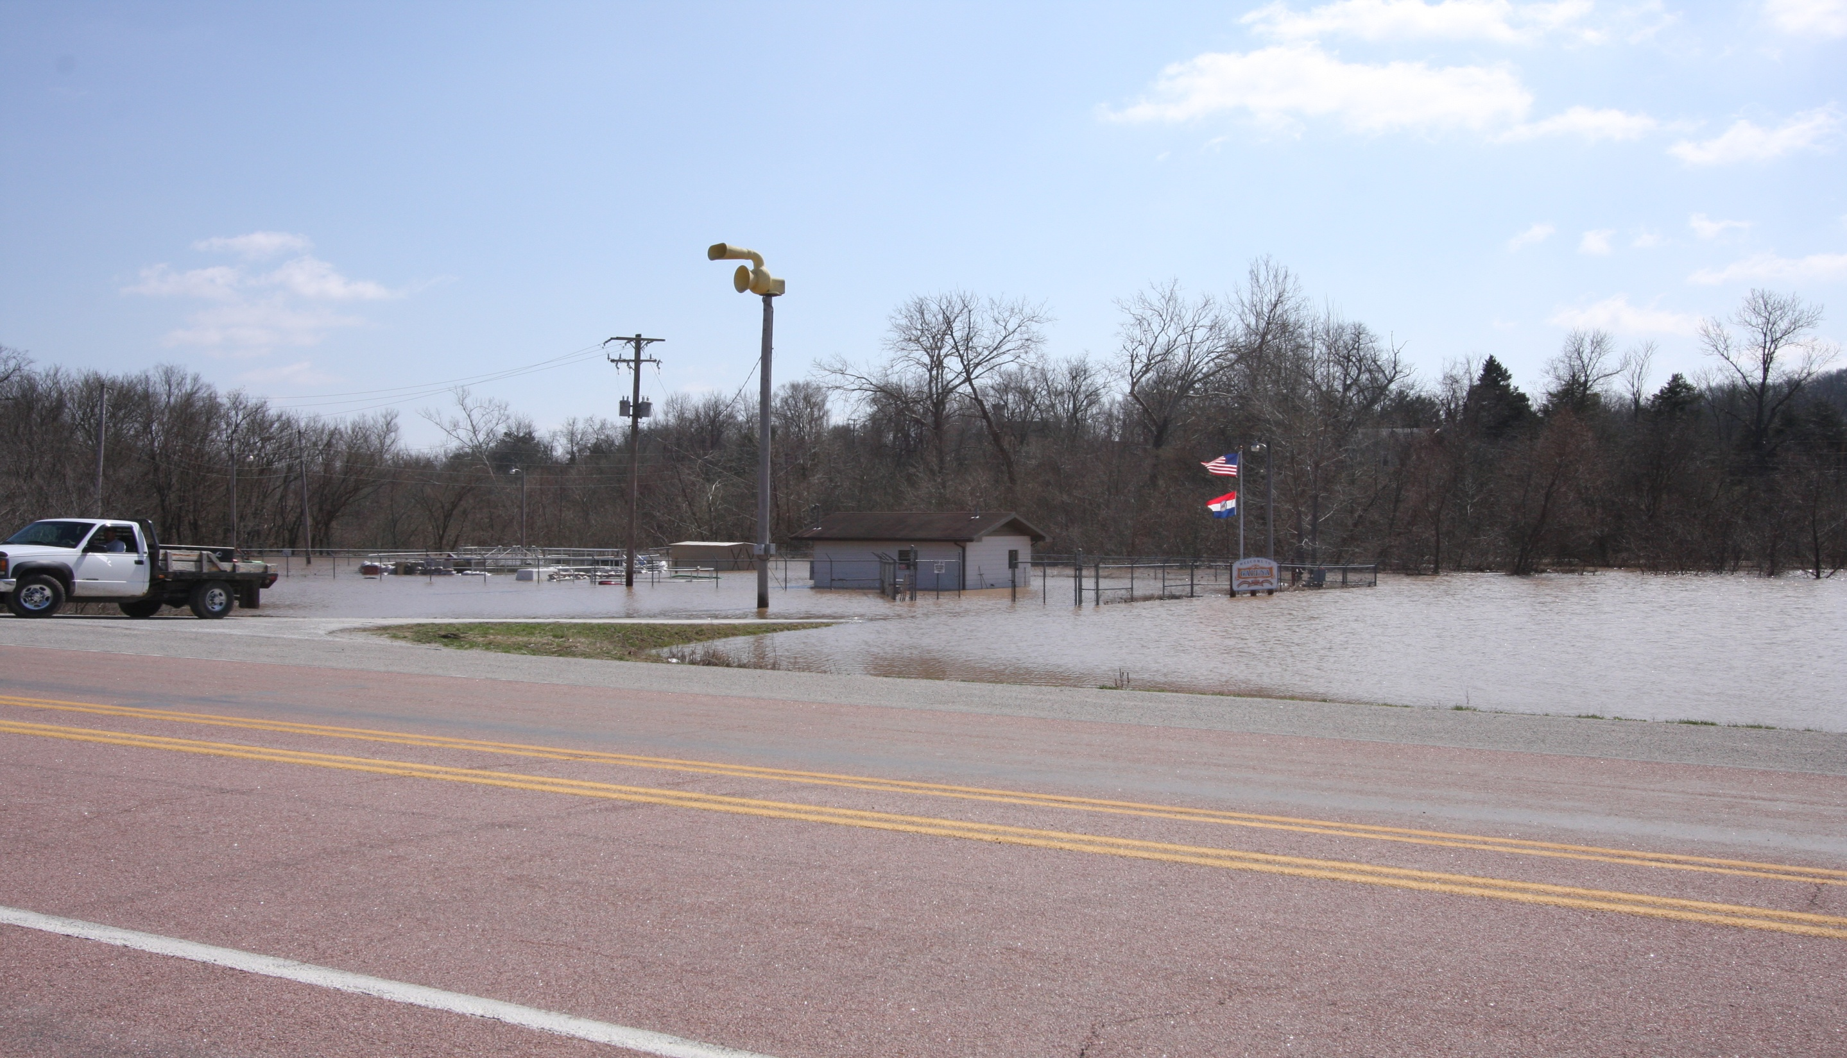
Flood 2008

Slide 16
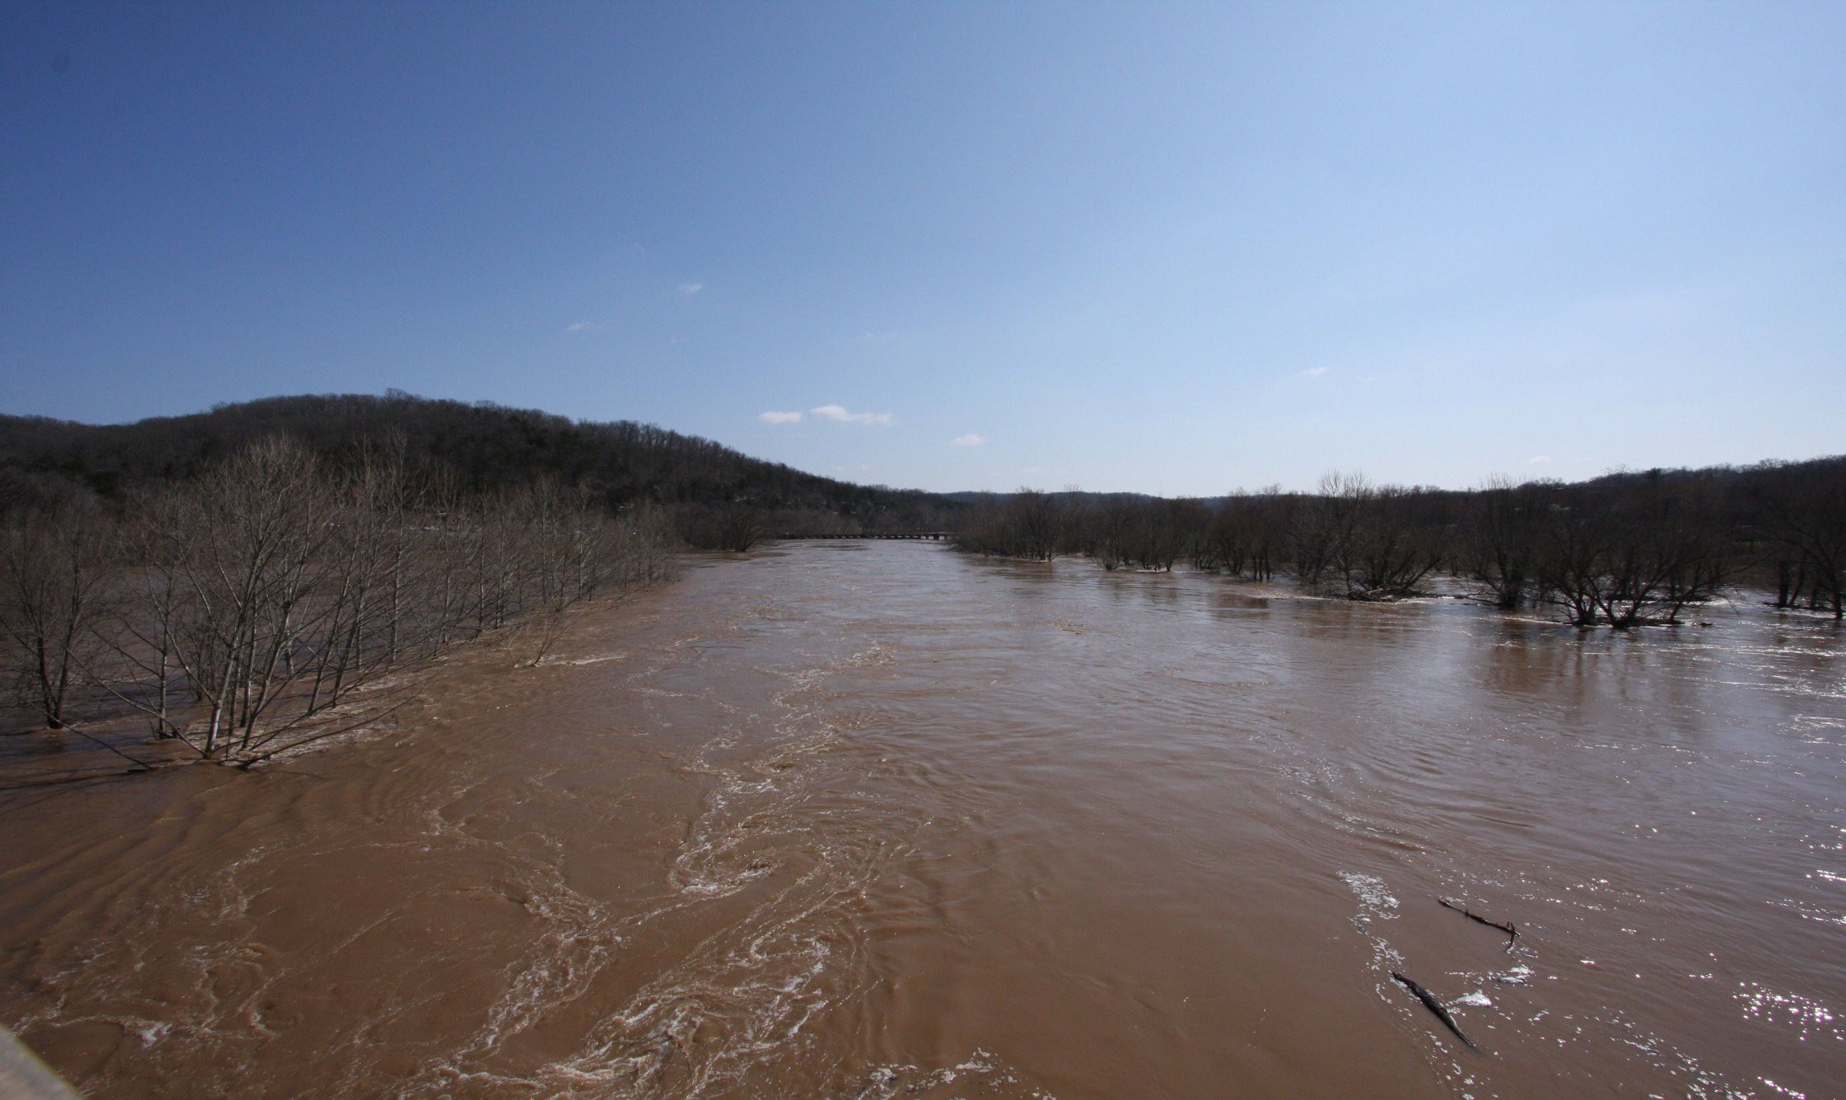

Slide 17
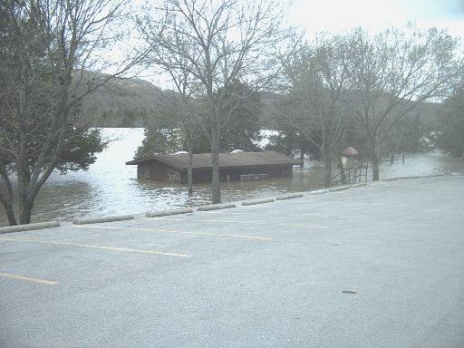

Slide 18
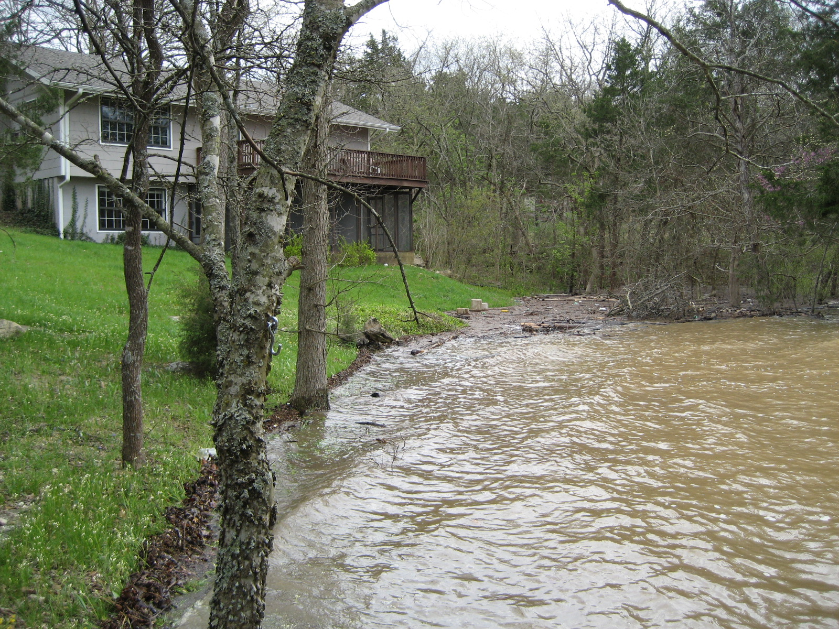

Slide 19
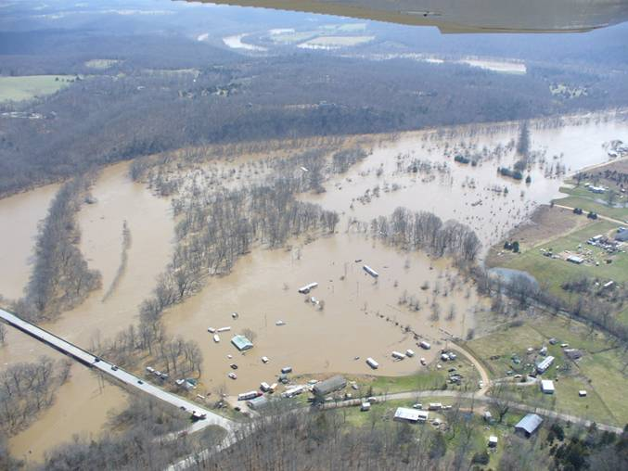

Slide 20
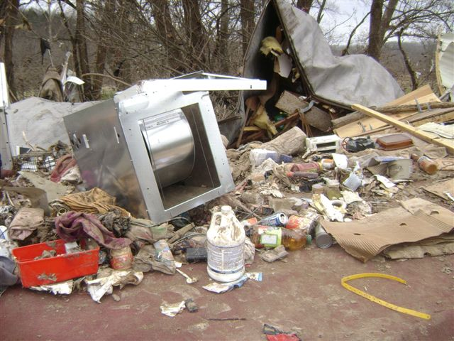

Slide 21
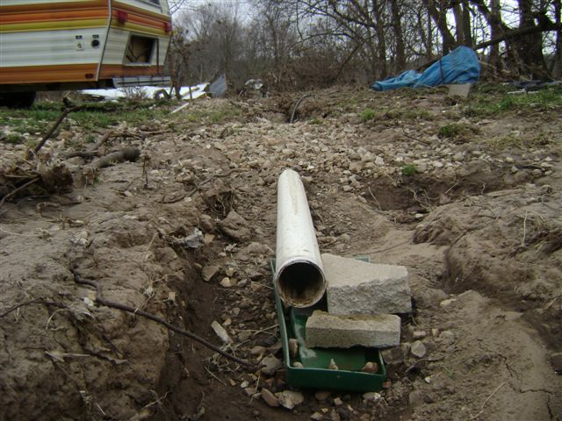

Slide 22
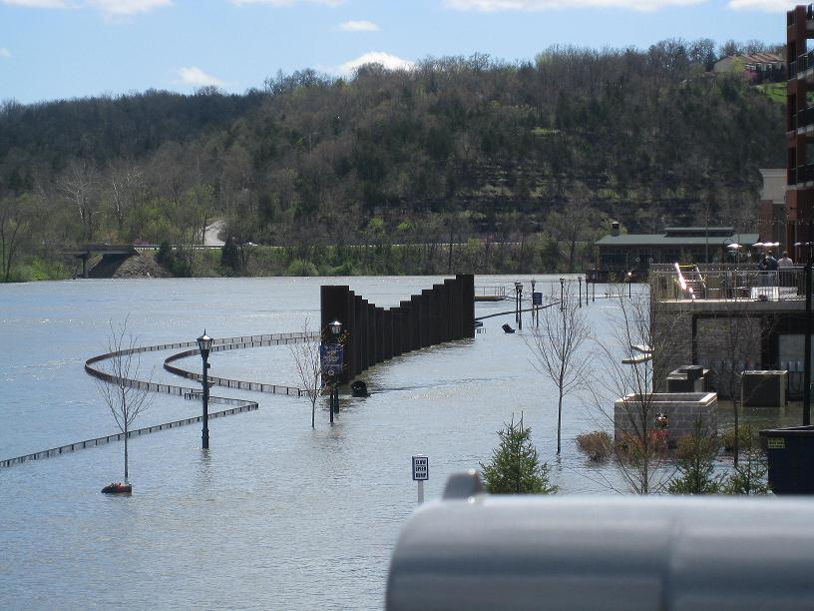

Slide 23
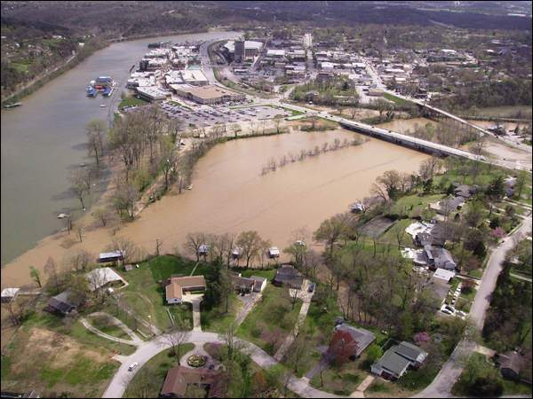

Slide 26
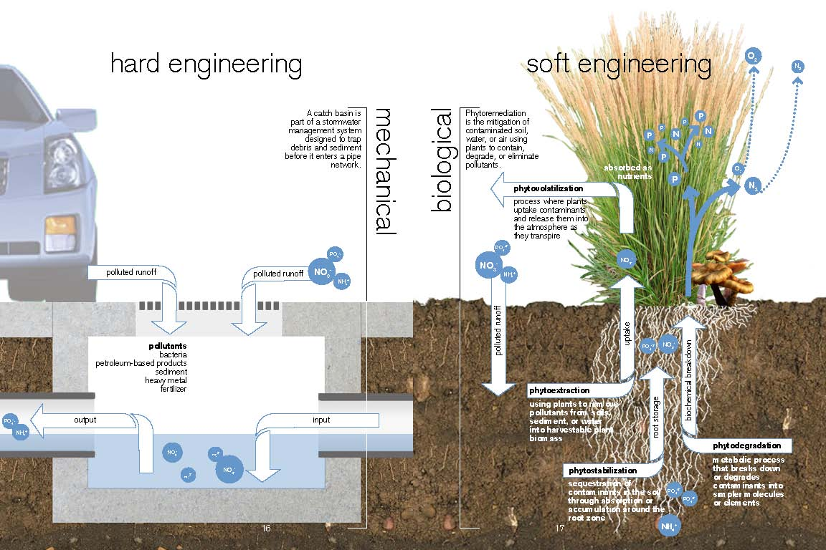

Slide 29
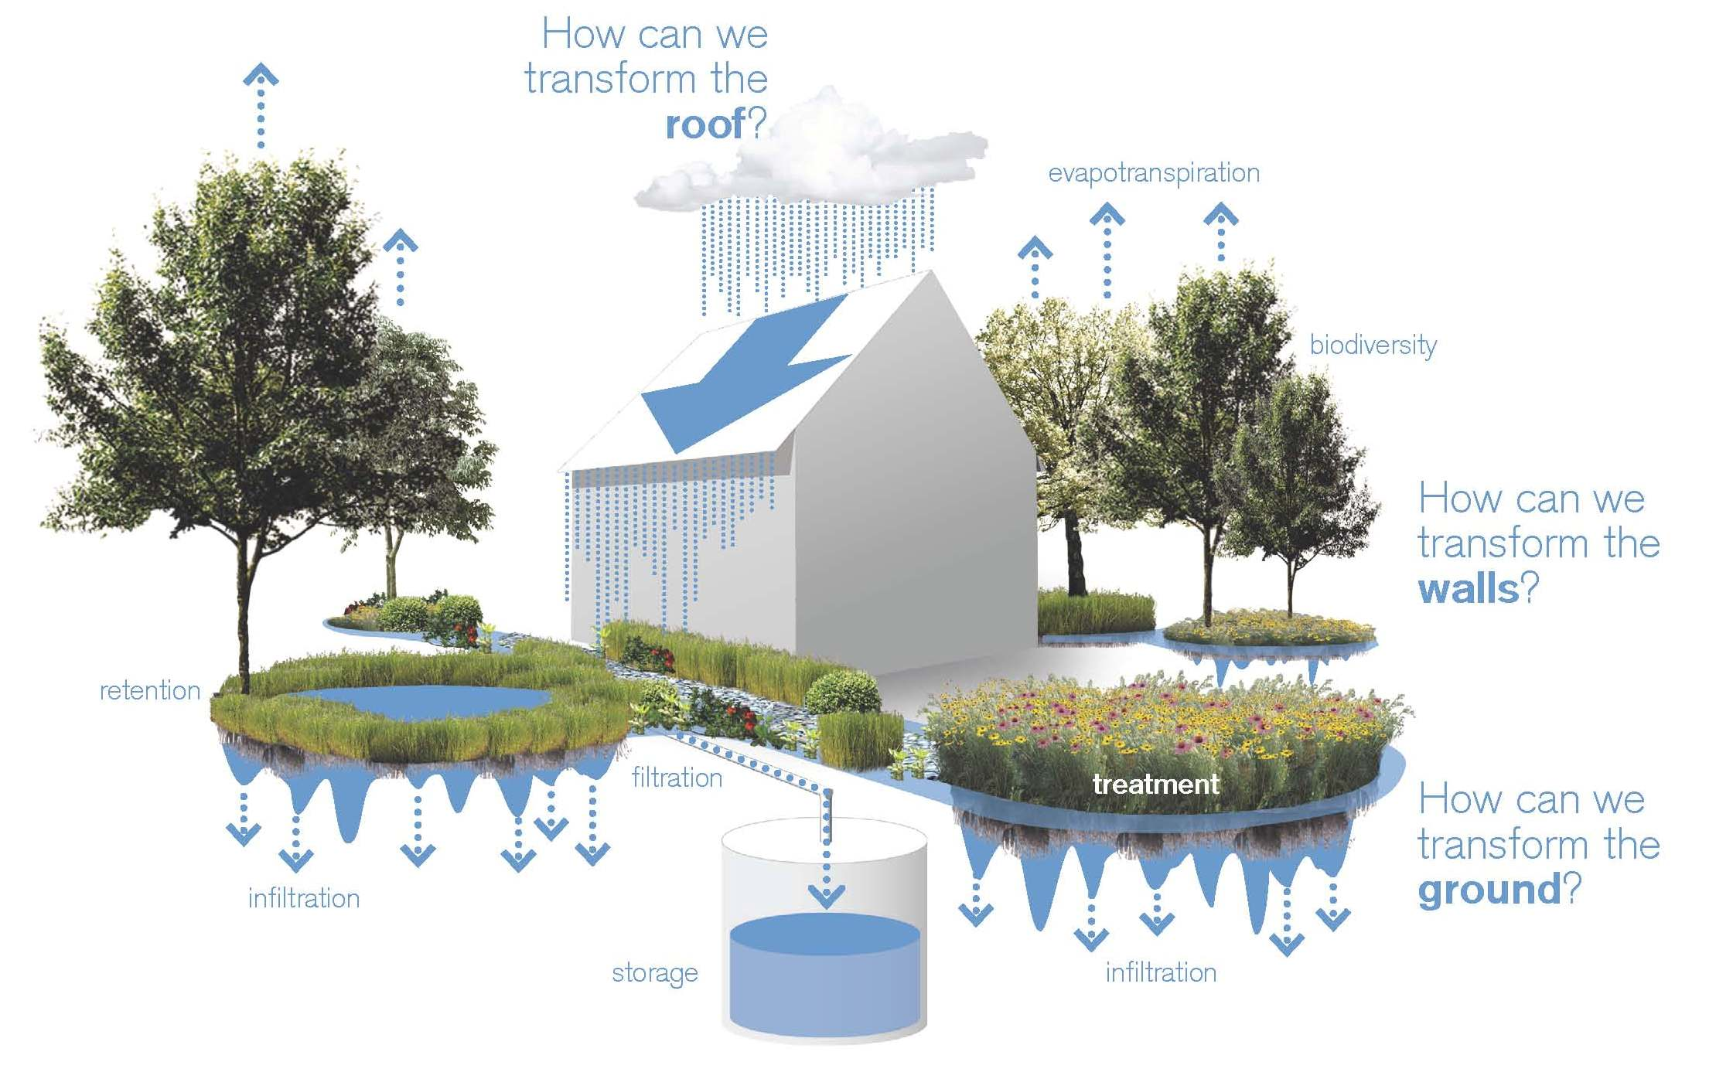
LID: Overview

Slide 31
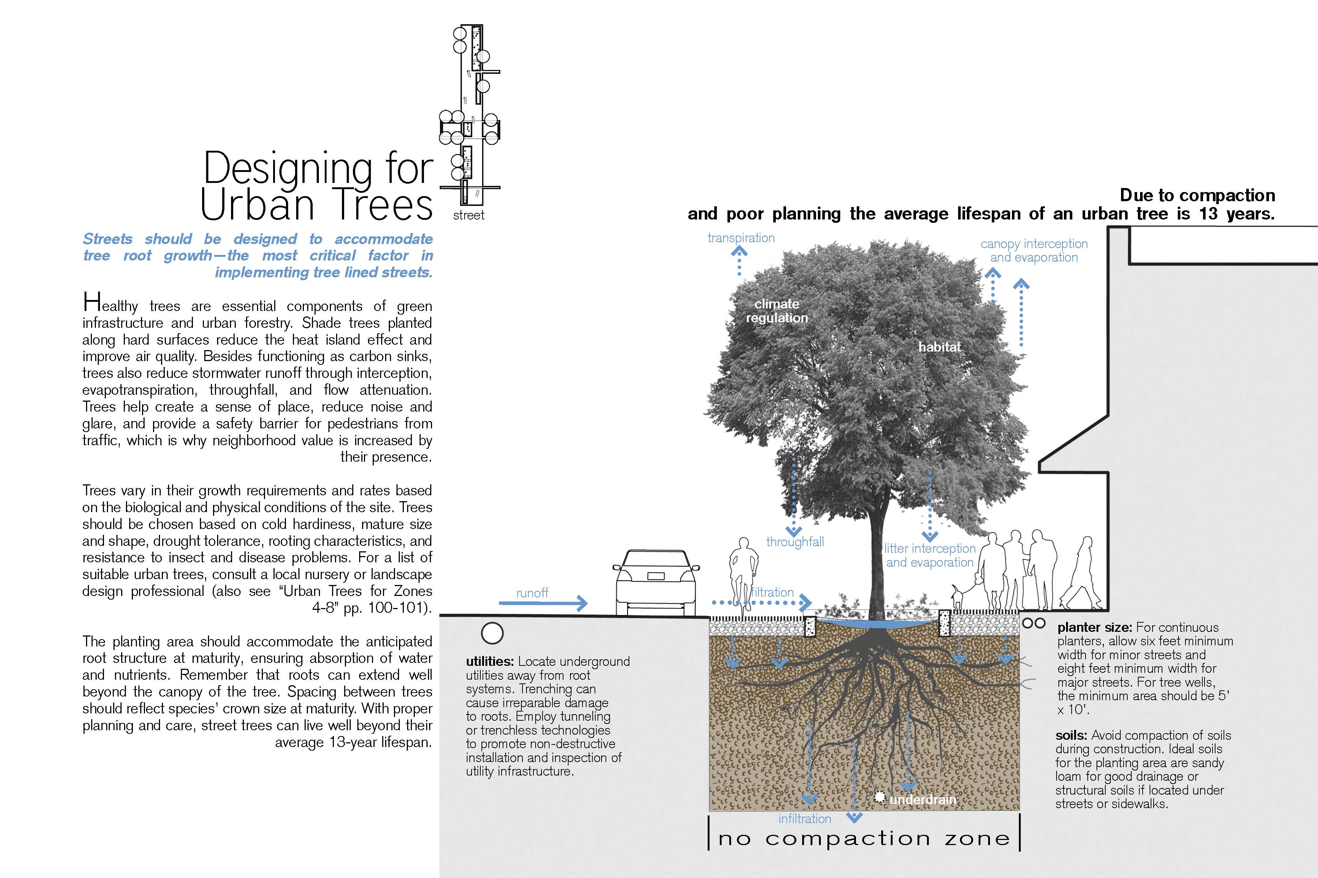

Slide 32
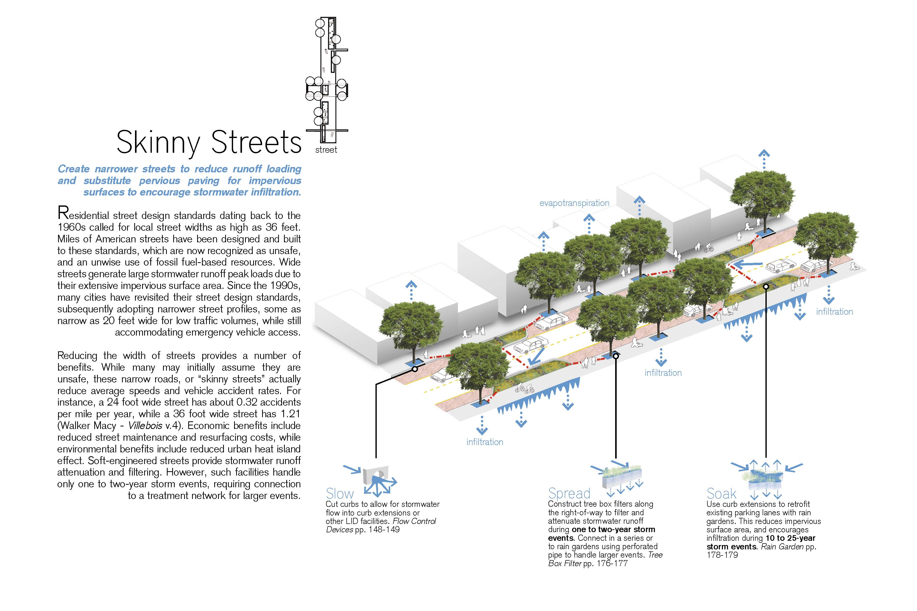

Slide 35
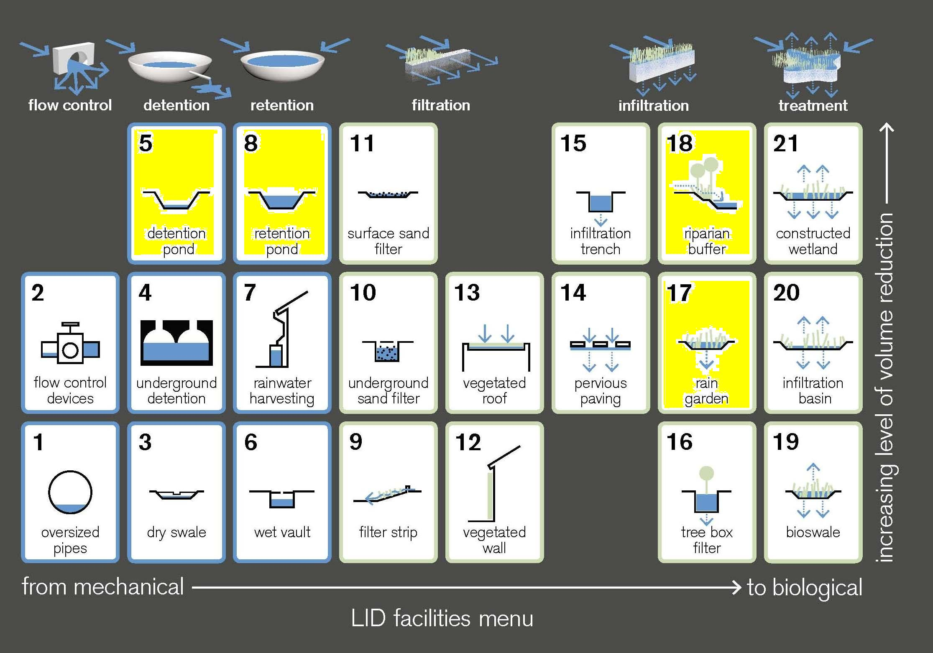
LID Facilities

Slide 40
LID: Low Impact Development a design manual for urban areas
Fay Jones School of Architecture
University of Arkansas
A Collaboration
Fayetteville 2010
http://uacdc.uark.edu
Over 225 pages
$30 a copy

Slide 41
Springfield, MO

Slide 42
www.greencircleshoppingcenter.com

Slide 43
What is Green Building?
Building Responsibly
Triple Bottom Line:
Environmental, social, economical
Materials and Resources
Natural Capital is a metaphor for the mineral, plant, and animal formations of the Earth's biosphere when viewed as a means of production.
Site Selection
Energy Conservation
Construction Waste Management
Indoor Environmental Air Quaility
Water Quality and Water Efficiency

Slide 44
Green Circle Project Goals
New Location for Developers Business’s
Community Leadership
Platnum LEED Certification
From Novelty to Necessity
……..

Slide 46
Construction Costs
20% Higher Upfront Costs
Stormwater Management
Efficient Energy Systems – Lighting & Mechanical
50% Energy Efficiency Cost Reduction
Higher lease rate
Tenants make up (& more) with energy savings

Slide 47
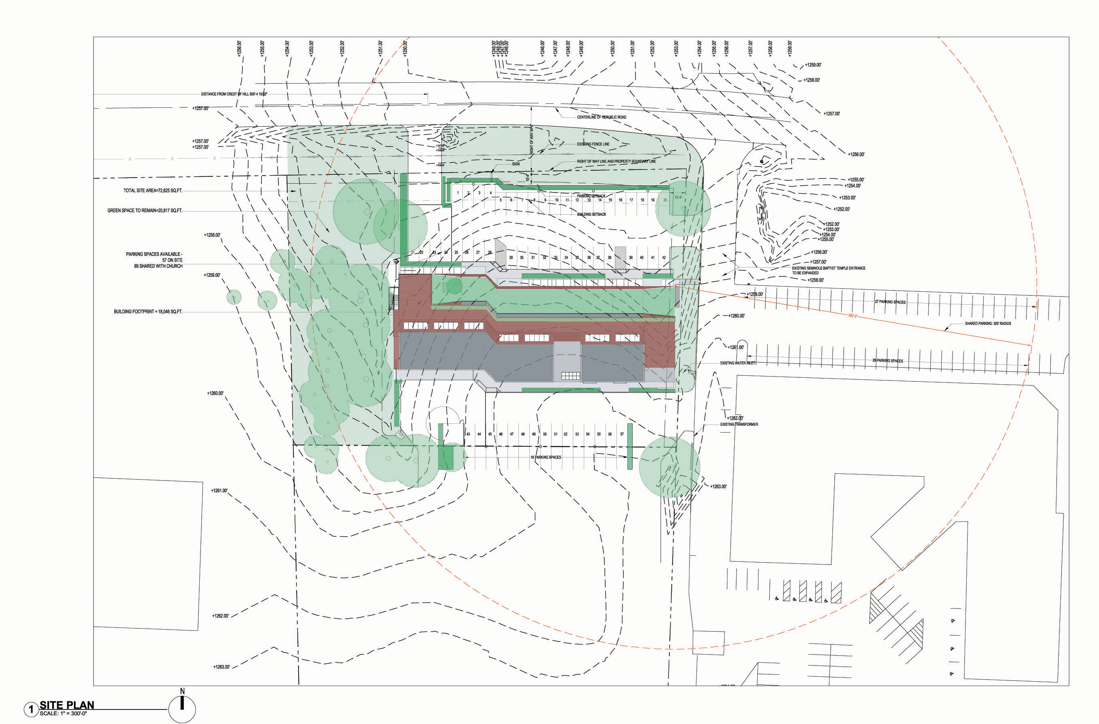
Site Challenges
Small Site – 1.7 Acres
Water Retention Threatens Trees
Parking is abundant but not within zoning regulations
Zoning requirements mandate Detention
But we don’t need detention!
Site Challenges

Slide 48
BMPs Best Management Practices
Pervious Concrete
Green Roof
Vegetated Swales
Rainwater Collection & Reuse
Shared Parking (with neighboring church)
Water Saving Fixtures
Energy Efficient Building Design
Energy Efficient Heating & Cooling

Slide 49
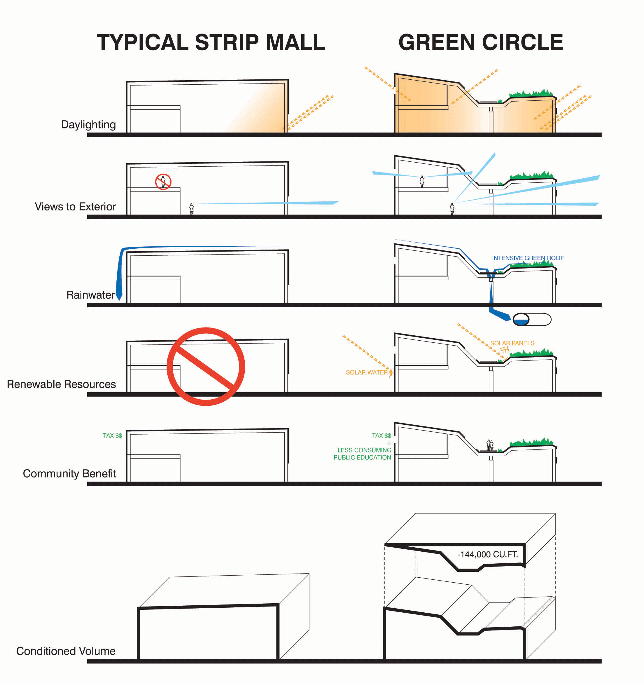

Slide 50
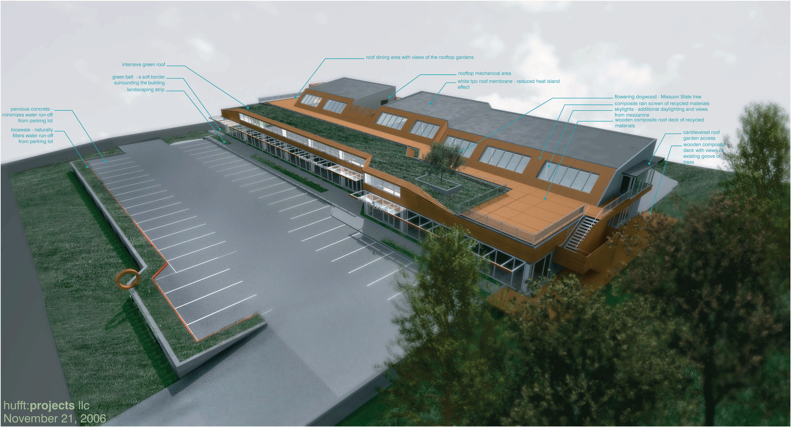
Site Features
23,000 Sq. Ft.

Slide 51
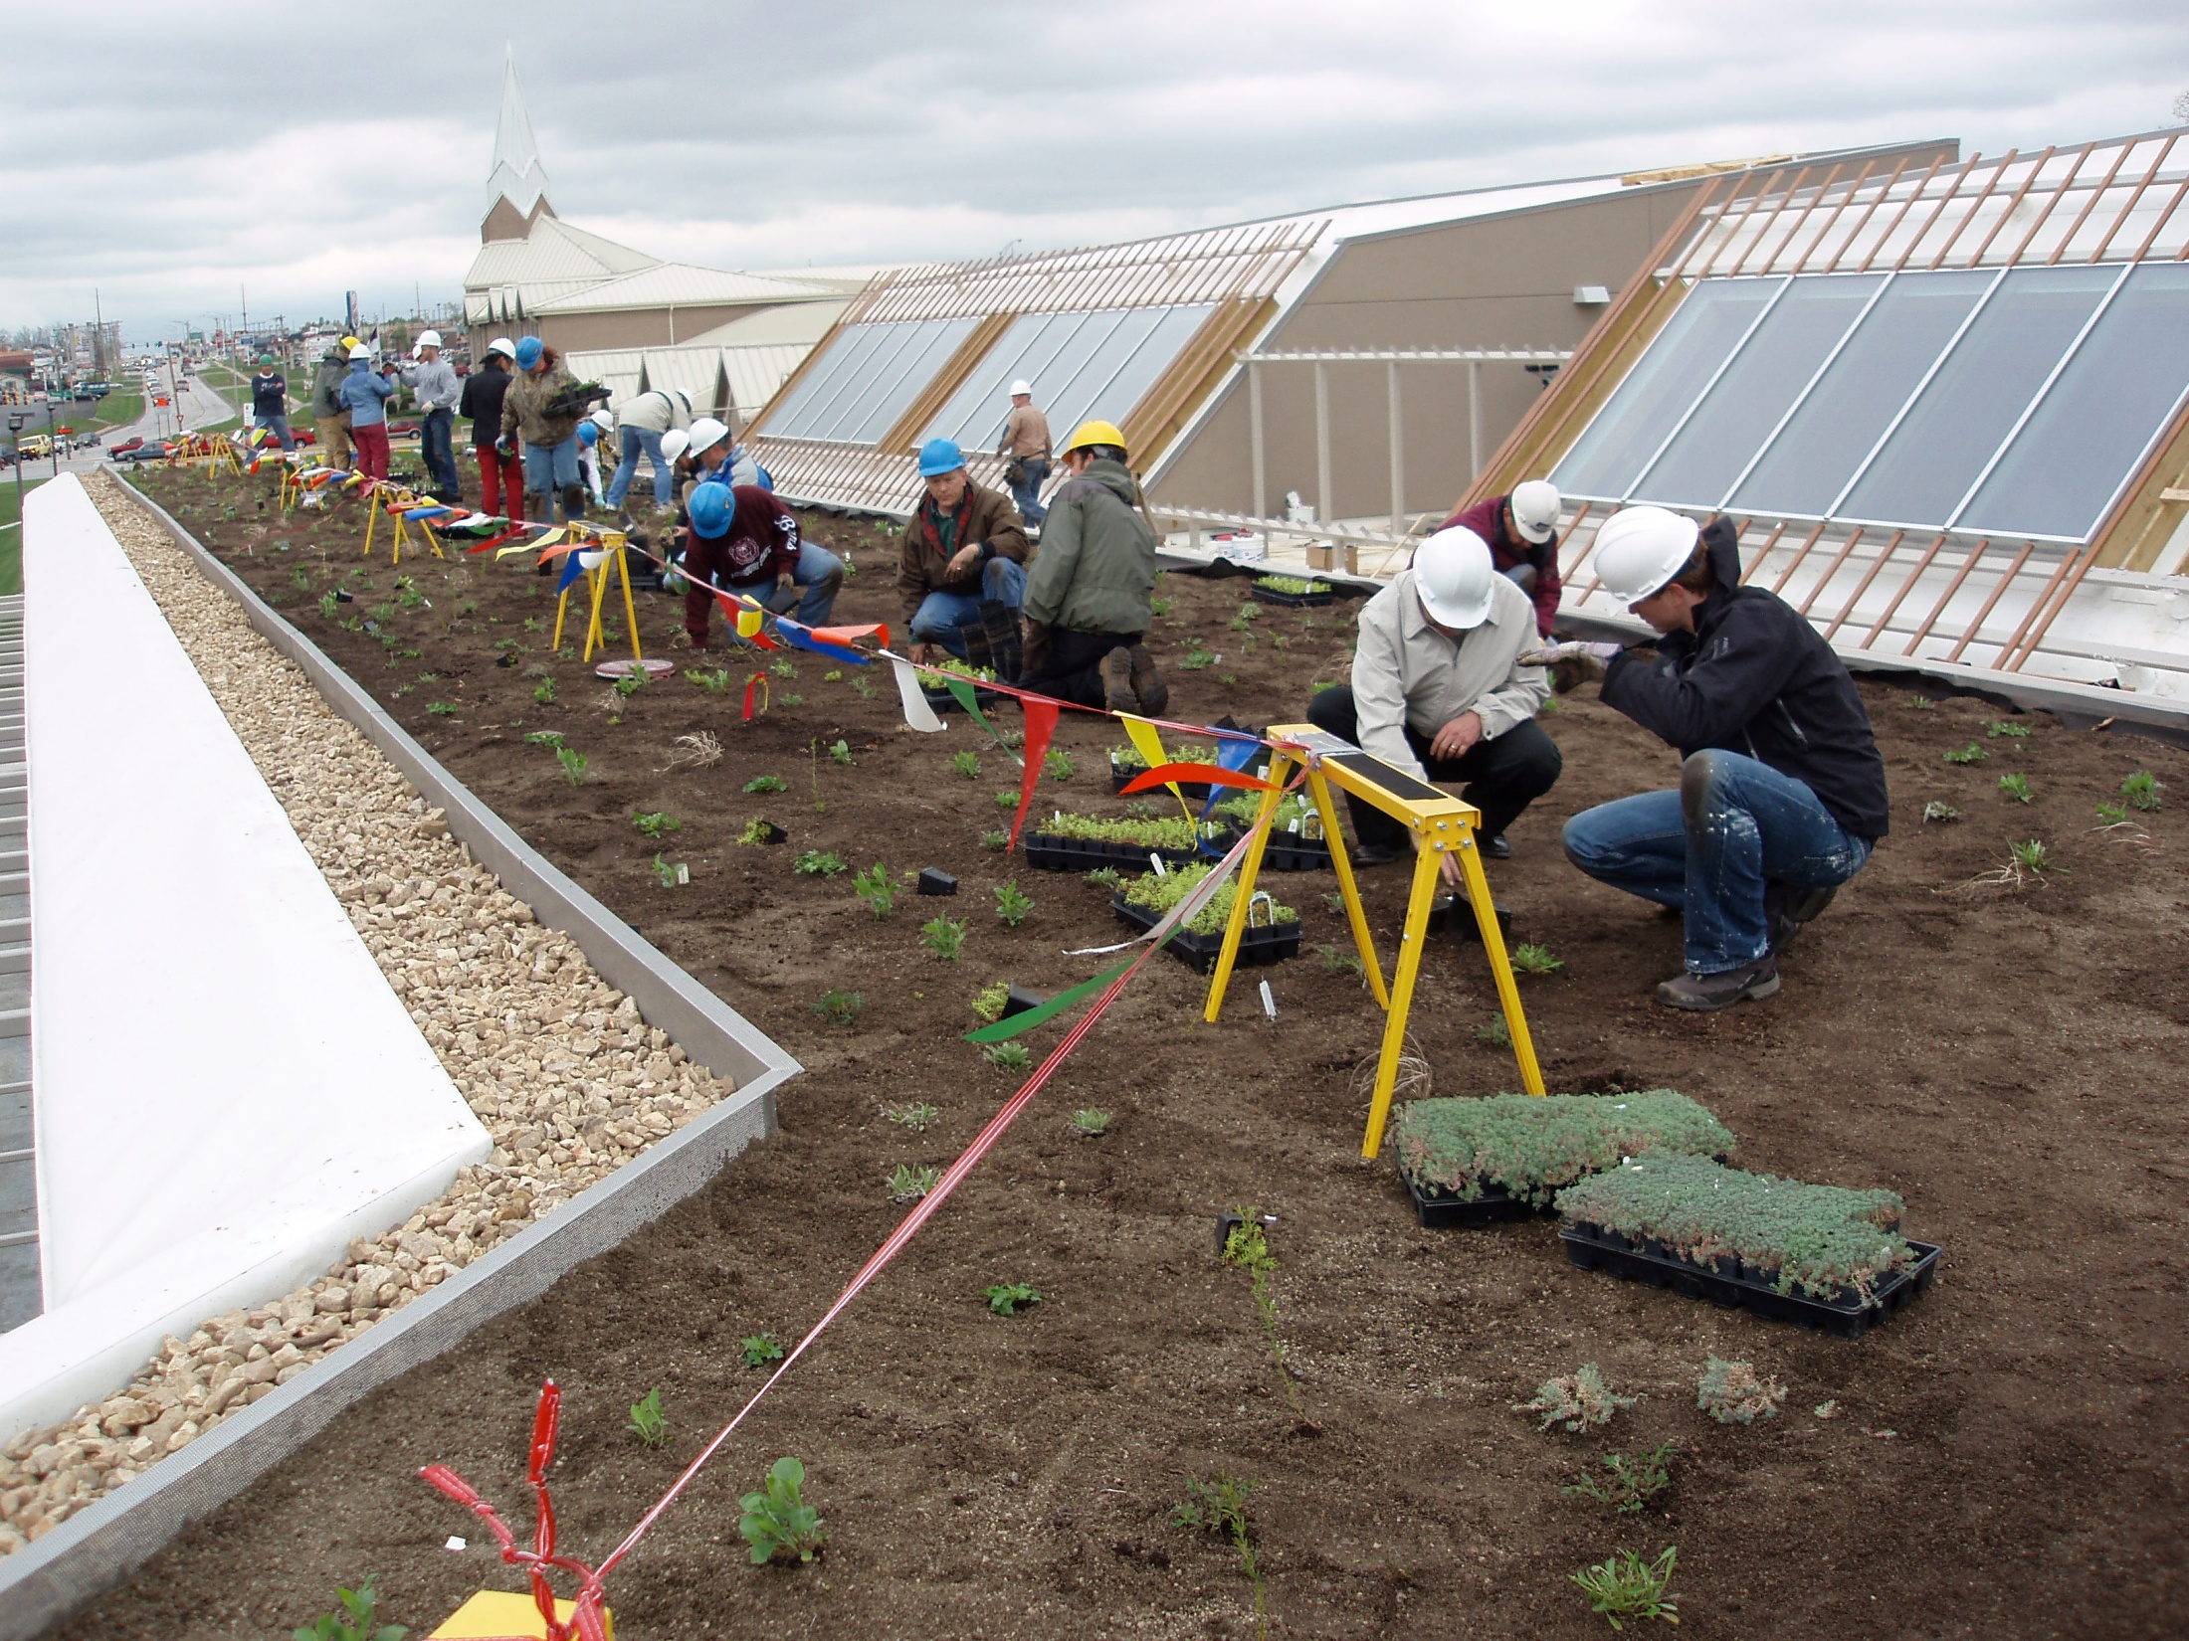
Green Roof

Slide 52
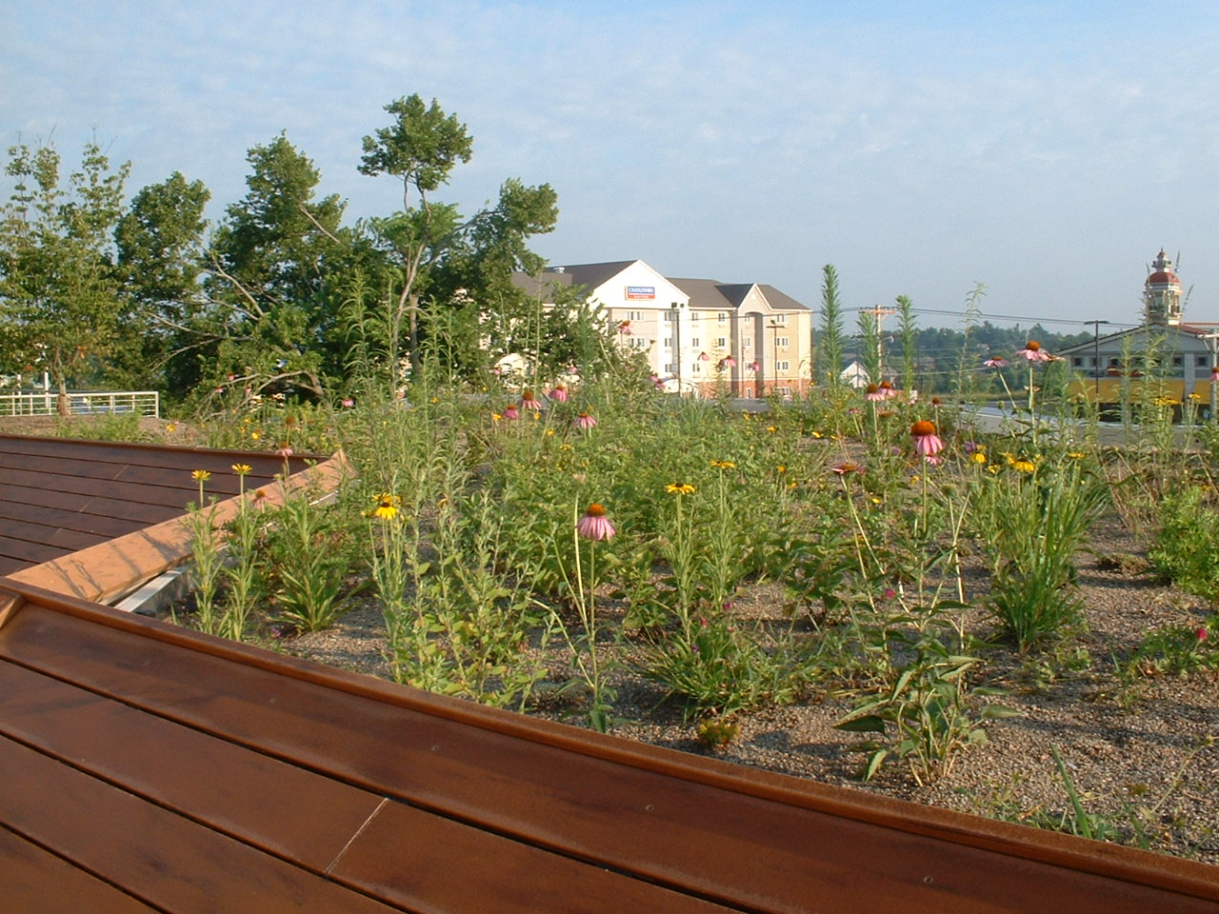

Slide 53
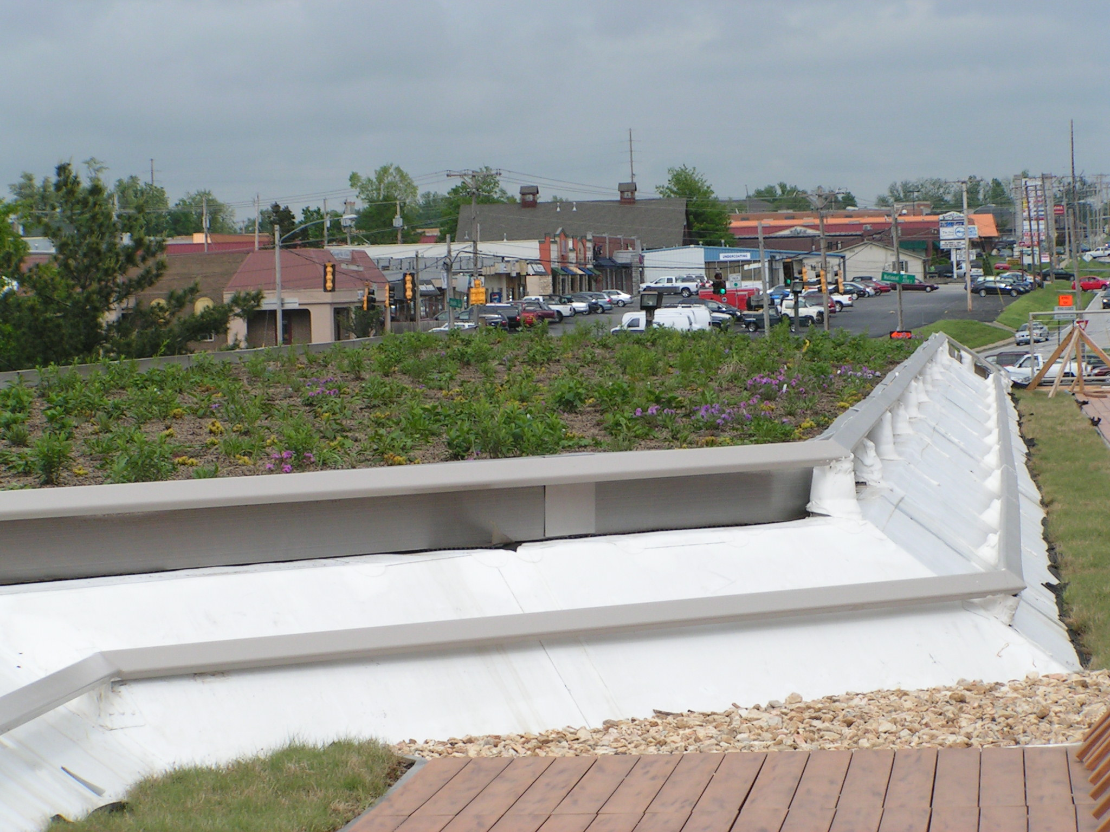

Slide 54
Green Roof
4,200 Sq. Ft.-8” Deep
Holds Approximately 5,200 Gallons of Rainwater
Native Missouri Plants
Capture & Treat Rainwater
Integrated Stormwater Management
Increased Roof Life (Double)
Energy Efficient
Noise Reduction
Recreational Space

Slide 55
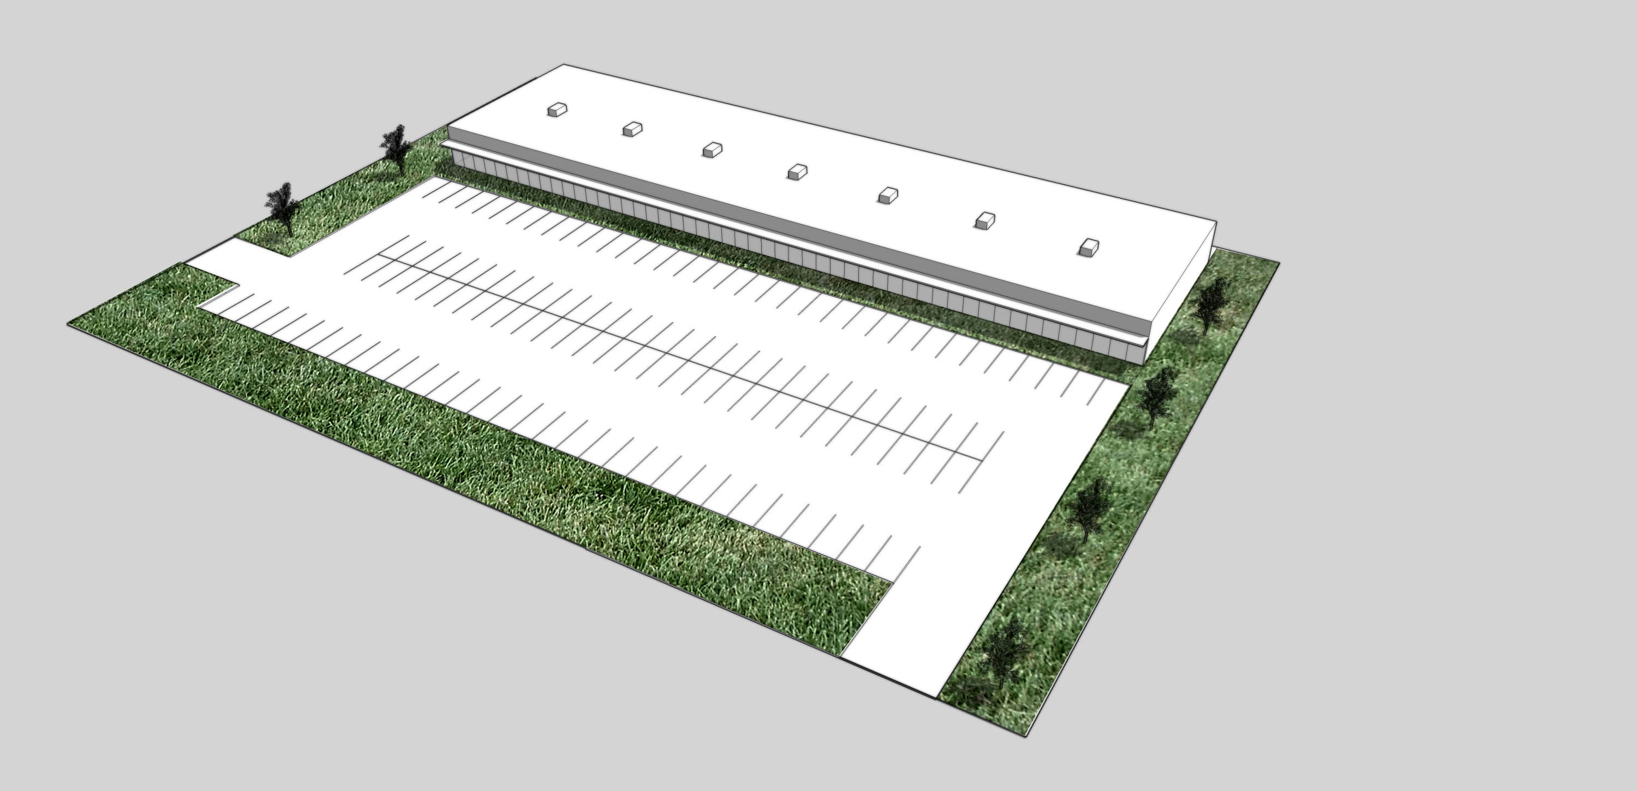
Land / Building Ratio typical strip mall

Slide 56
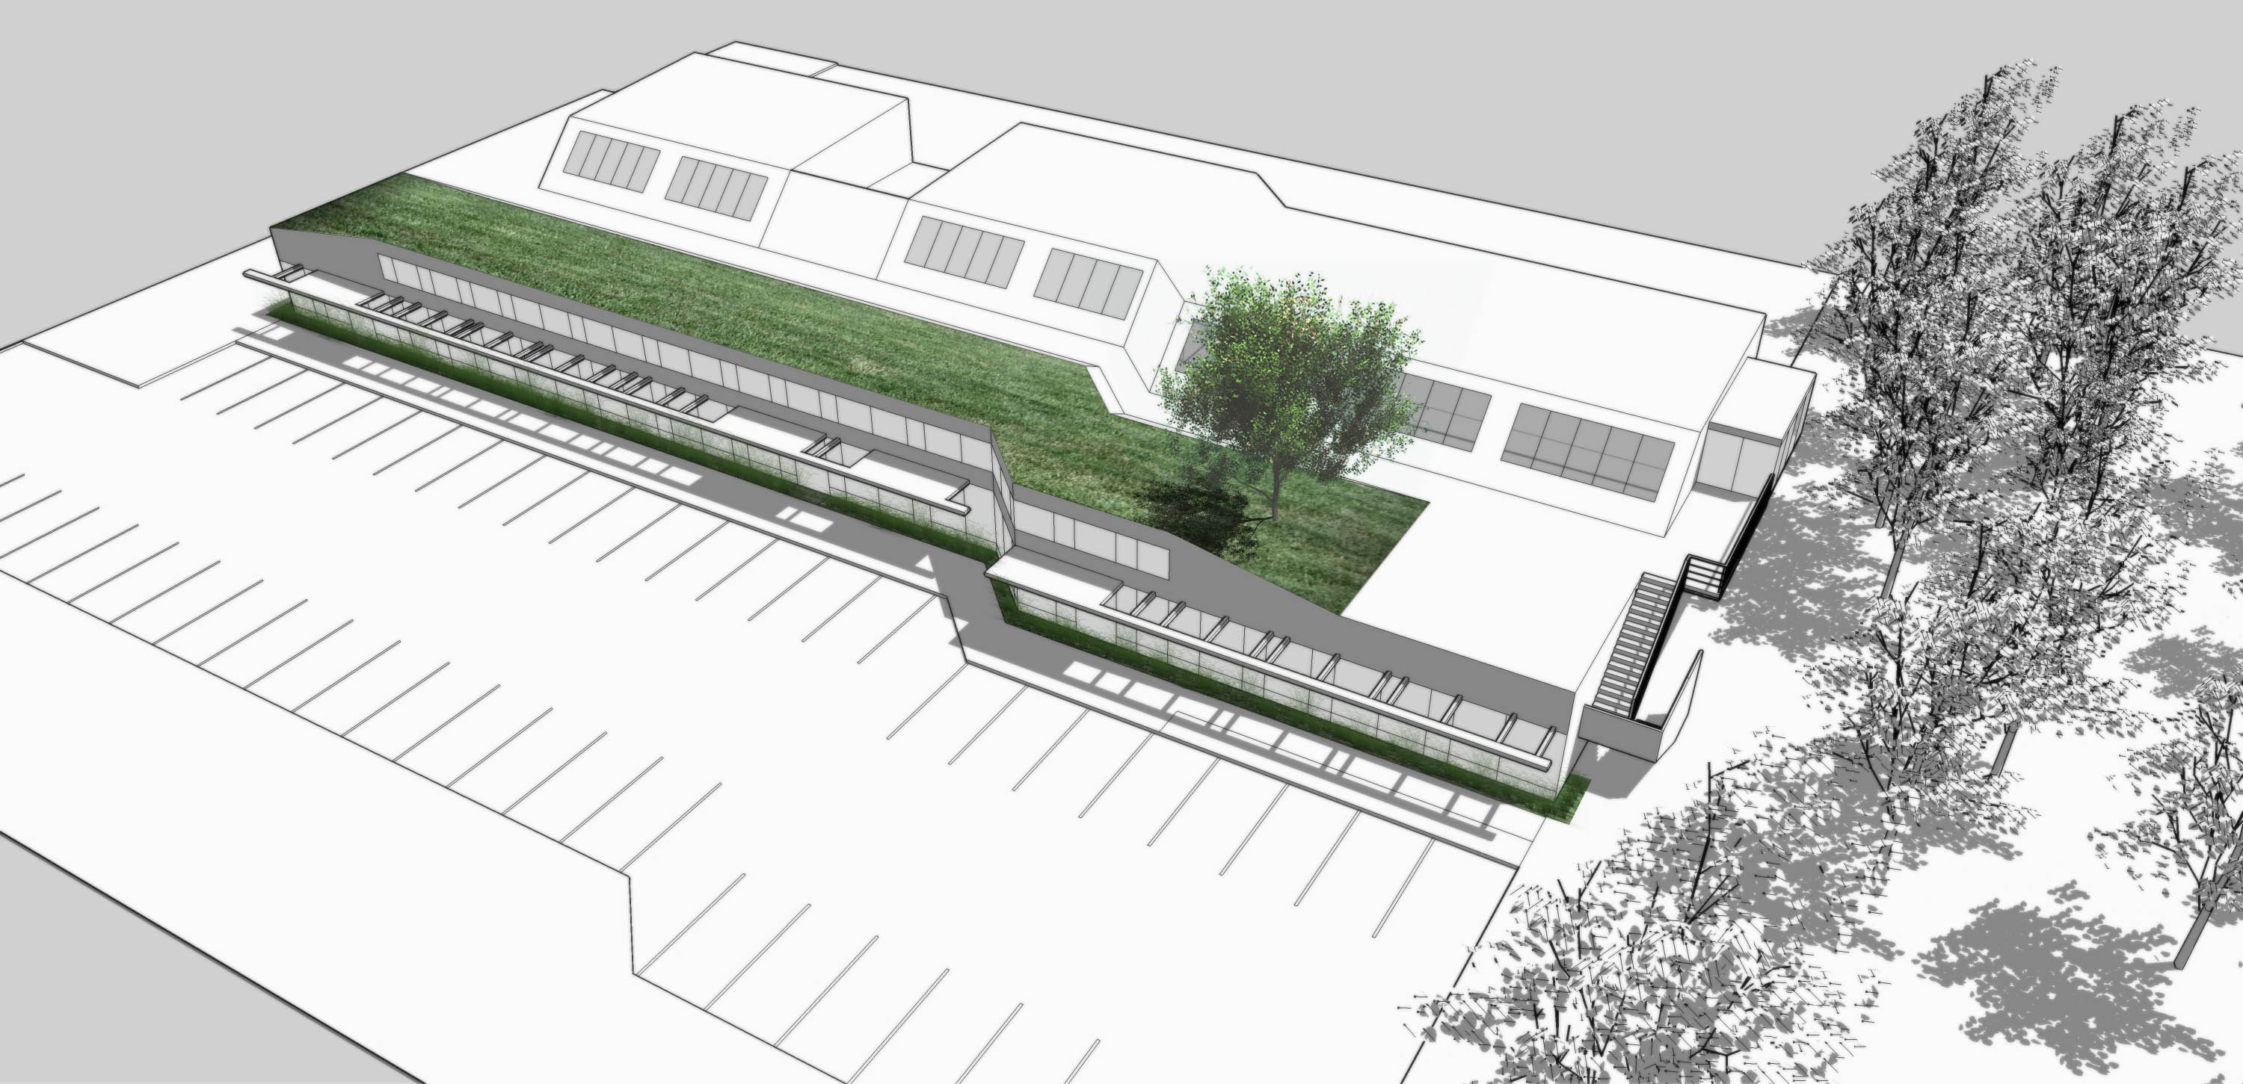
10,000 Gallon Cistern for rainwater harvesting

Slide 57
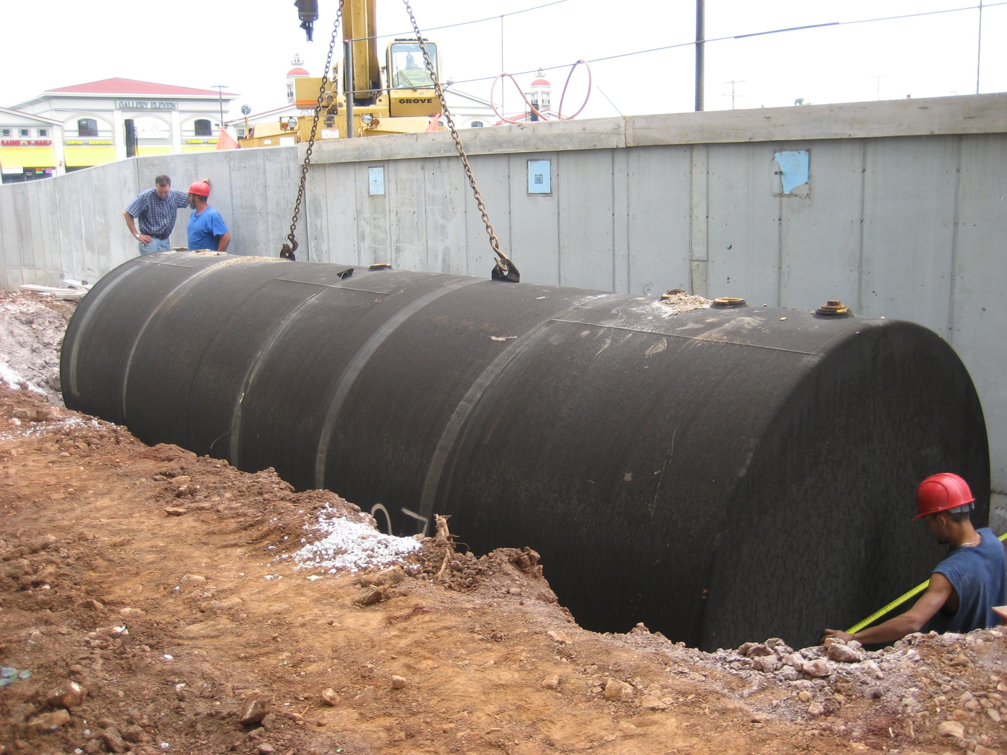

Slide 58
Rainwater Harvesting Applications
Landscape Irrigation
Toilet Flushing
Janitorial Water Use
Stormwater Management
Reduce Tenant Utility Bills
Locate Cistern Above or Below Ground
Provides Supplemental Water
70% Reduction of Domestic Water Use
3.5 Million Gallons of Water Annually

Slide 59
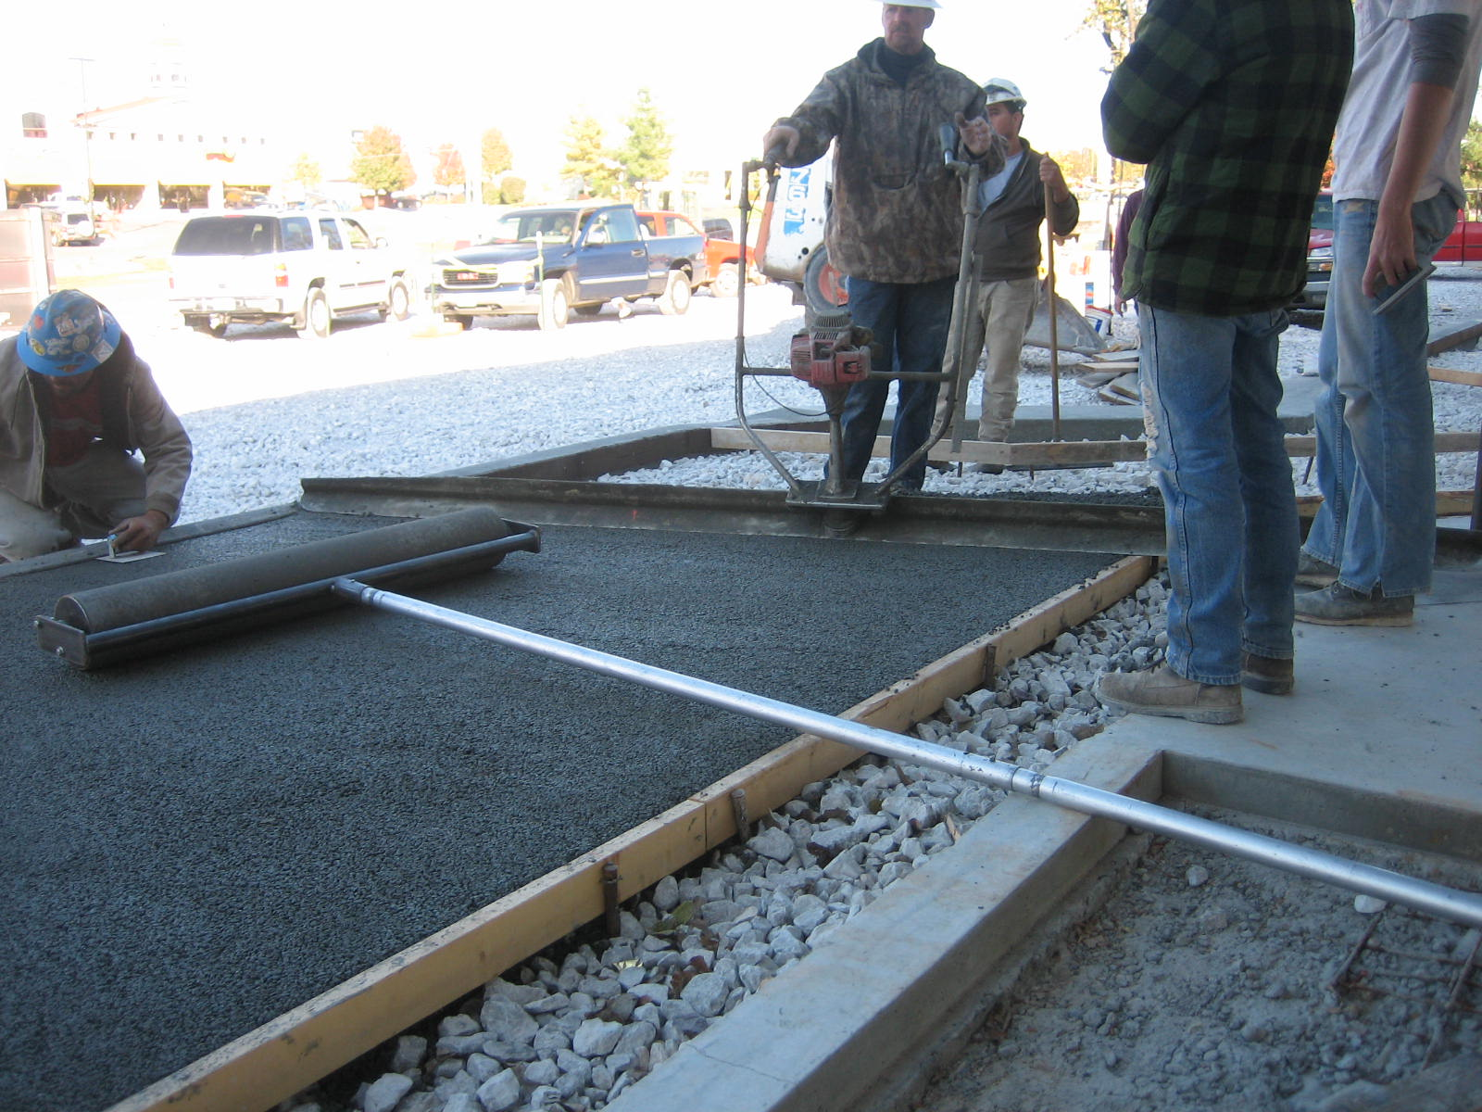
Pervious Pavement

Slide 60
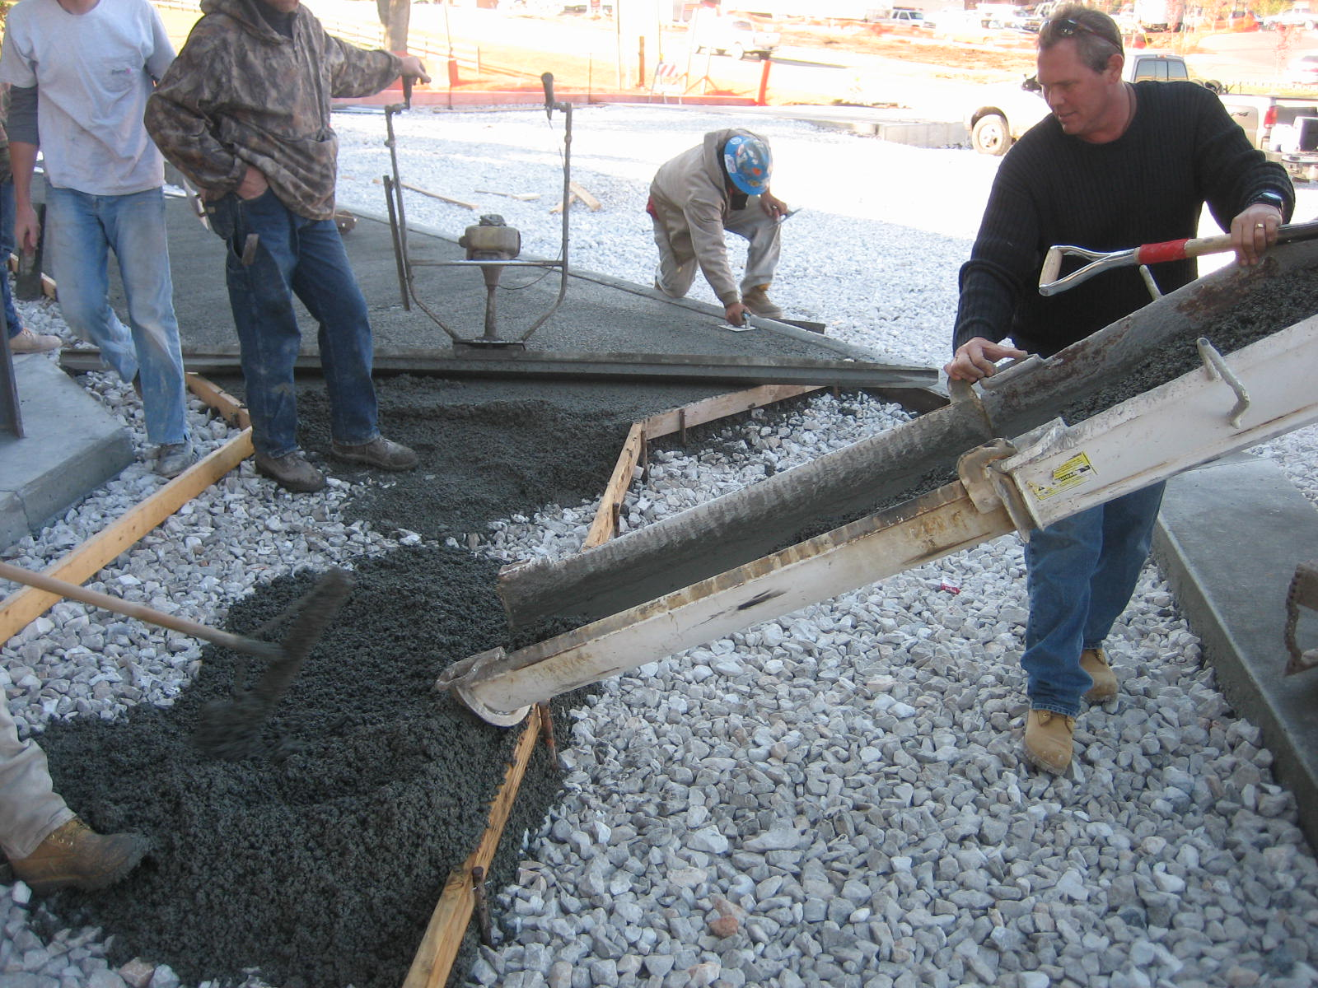

Slide 61
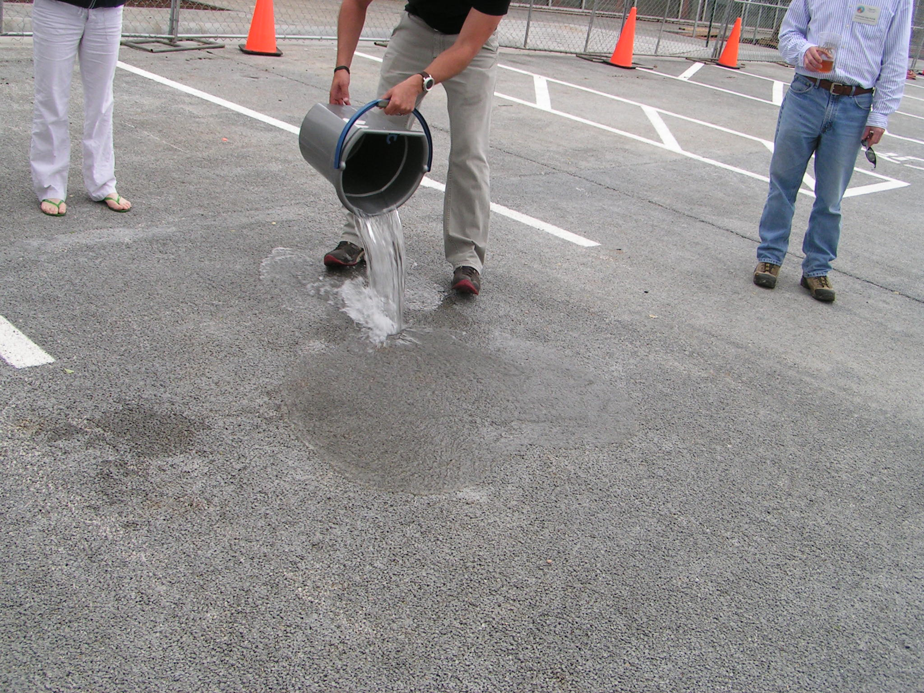

Slide 62
Pervious Pavement Benefits
Infiltration of Stormwater Runoff
Reduces Costs of Stormwater Infrastructure
Absorbs Less Heat
Protects Trees & Plants in Paved Areas
Removes Soluble & Particulate Pollutants
Total Suspended Solids: 80-90%
Total Phosphorus: 65%
Total Nitrogen: 80-85%
Heavy Metals

Slide 63
Preliminary Results
Almost No Stormwater Runoff
Any Runoff Not Absorbed by Roof or Pavement Enters the Water Quality Swale, or Filter Strip and Seeps into the Vegetation and is Filtered as it Drains

Slide 66
Administration Building Features
Pervious Pavement
Natural Lighting
Motion Detectors for Electric Lights
Energy Efficient Heating & Cooling Systems (Geothermal)
Recycled Materials in Cabinetry & Insulation
Water Saving Fixtures
Low Flush Toilets
Waterless Urinals
Automatic Water Faucets

Slide 67
Administration Building Features
Cont.
Man Made Creek
Fed by Recycled Water from the Water Plant
Planted with Native Flowers & Shrubs
Infiltration Basins (Hold & Treat Runoff)
Basin Plants can Tolerate Submerged and Dry Conditions

Slide 68
Pervious Pavement

Slide 69
Bioretension Basin

Slide 72
(Natural) Overflow Parking

Slide 73
Other Sites
Rain Gardens
Water Harvesting

Slide 80
Rain Barrels
$25.00 instant rebate for Greene County residents
600 gallons of water from 1,000 sq. ft. catchment area in a 1 inch event.

Slide 81
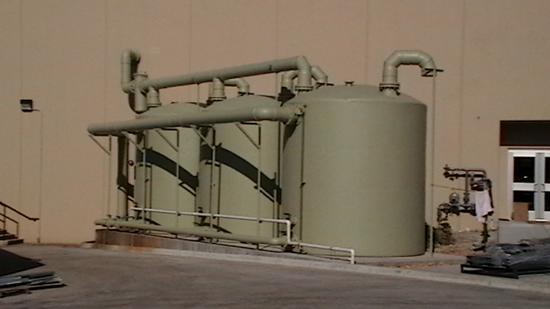
City of Ozark Community Center
3-10,000 gallon cisterns installed for irrigation purposes

Slide 82
LID Watershed Approach
LID employs the “Watershed Approach”, a holistic stormwater management system based on watersheds as planning units, rather than political jurisdictions and legal property boundaries. The approach integrates economics, ecological science, and social dynamics in development processes within the context of a watershed. LID works by utilizing the natural processes of the water cycle governing watersheds. LID is ultimately a place-bound approach dependent upon the integration of local soil, plant and hydrological communities.

Slide 83
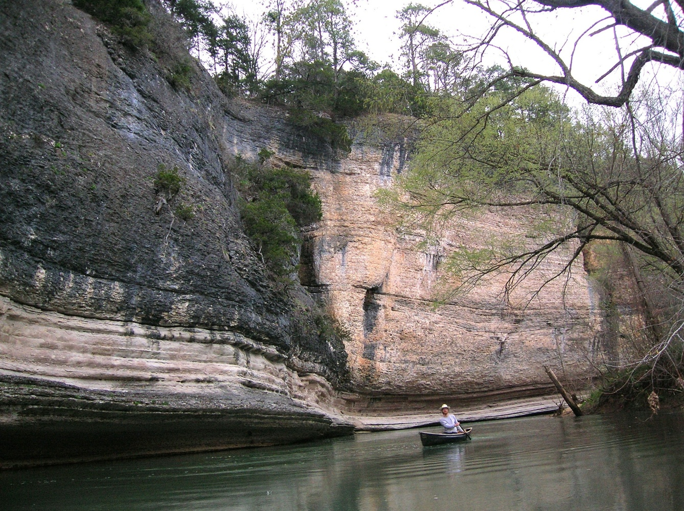
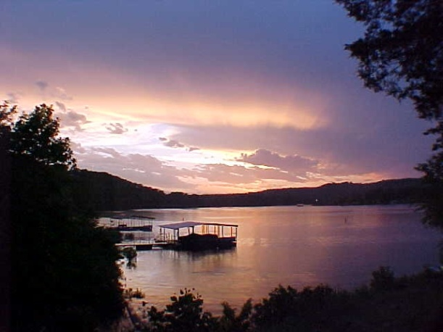
Thank You!
www.ozarkswaterwatch.org
Notes:
End.

